Slide 1
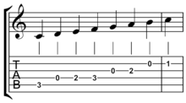
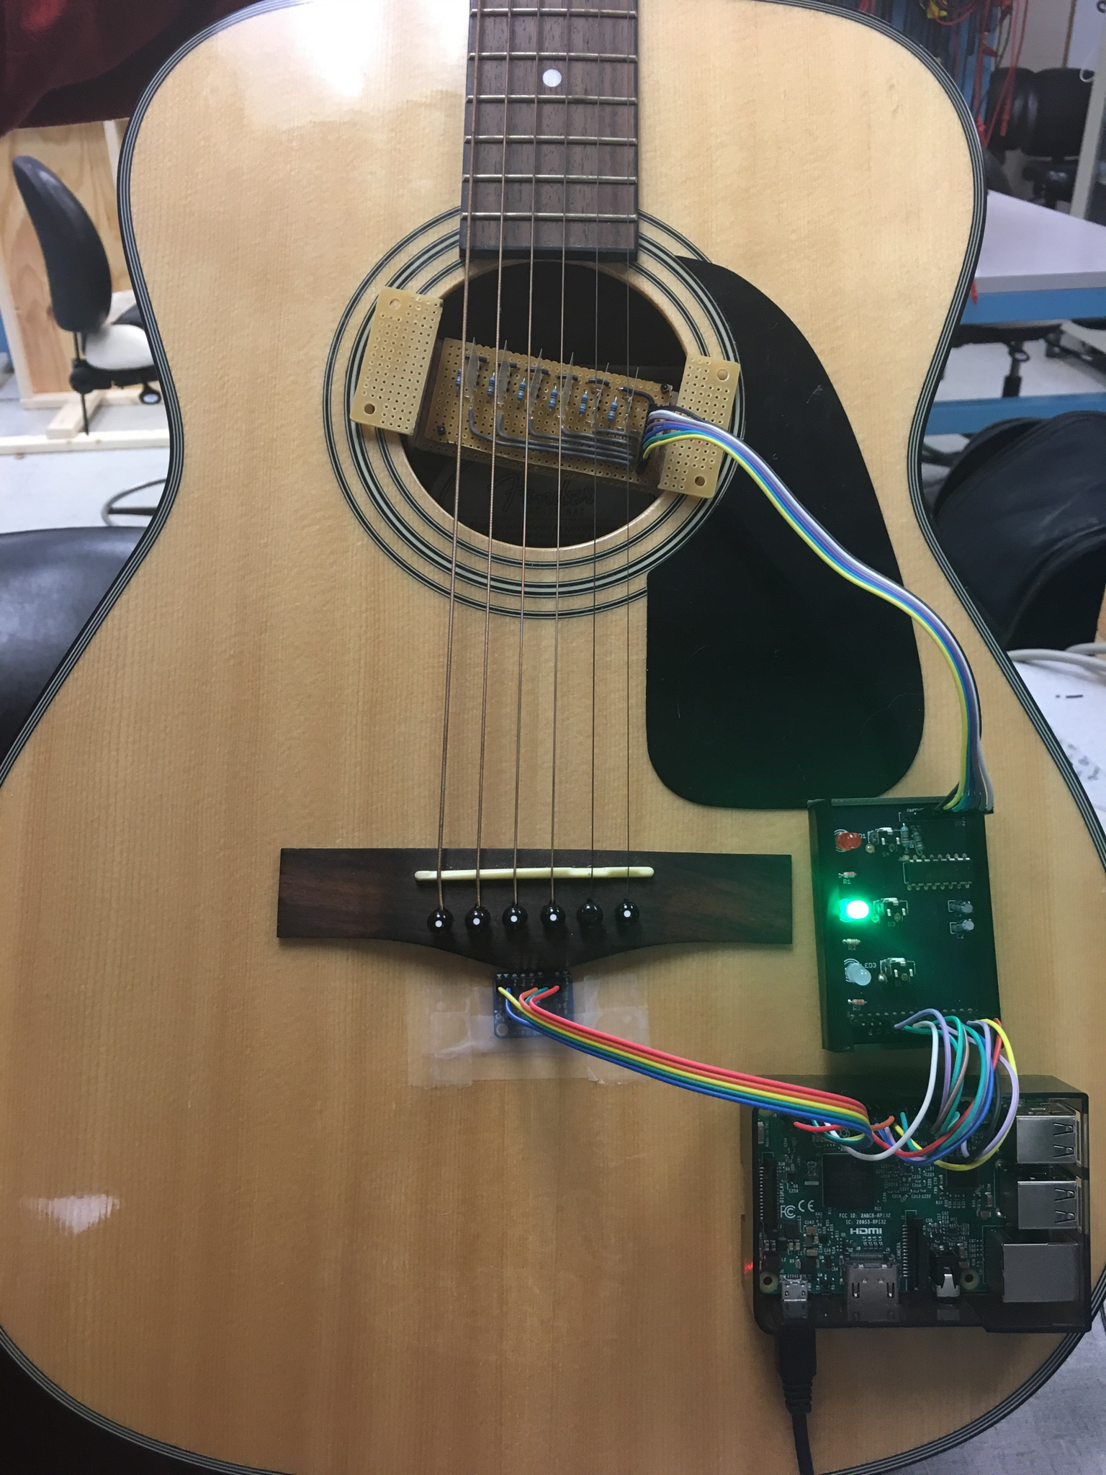
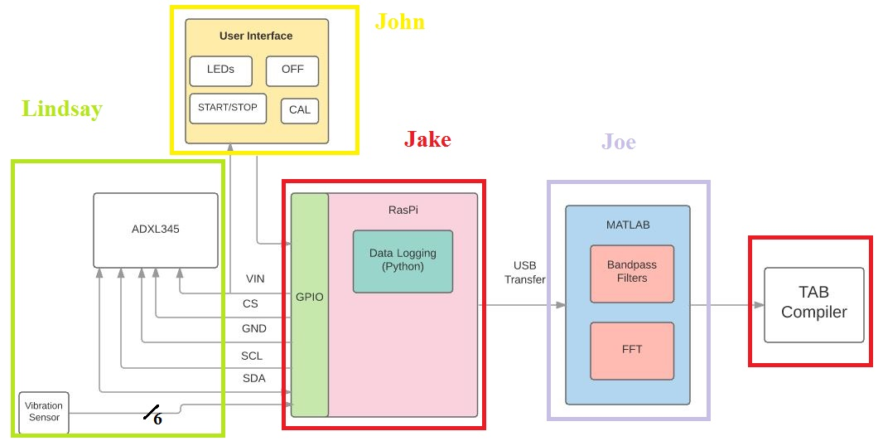
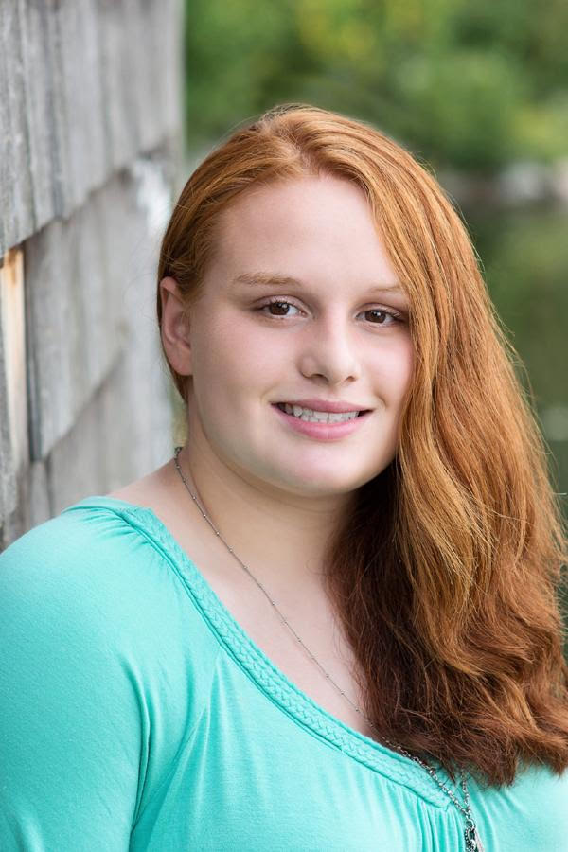
QuickTab
Joe Biegaj, Lindsay Manning, Jacob Prescott, John Bonk
Faculty Advisor: Prof. Patrick Kelly
Abstract
System Overview
Quicktab is a recording system that can be easily attached to most acoustic guitars and allows guitar players of a variety of skill levels to quickly and easily generate their own tablature simply by playing their guitar. Ideal for use as a teaching aid, QuickTab enables instructors, both online and in person, to share an accurate, visual representation of what they are playing. No longer must users learn how to use online software for creating tablature as what they play is what they will see.
Quicktab uses both an accelerometer, attached just below the bridge of the guitar, and six vibration sensors on the strings, to detect the vibration resonating in the guitar and the specific string being played. After the user specifies that they have completed their recording, the data is sent via e-mail to a PC where our Matlab code uses FFT’s to determine each note that was played and compiles the resulting information into easy-to-read tablature.
A critical part of our project is taking the frequencies recorded by our accelerometer and translating them into fret numbers. To do this, we use the formula shown below:
Block Diagram
By using this formula in coordination with our calibration function, we are able to determine the base frequencies of the guitar using QuickTab to determine the frets being played.
Results
We believe that project QuickTab is a success. There have been several similar projects in the past years, however none of them have been nearly as successful as our team. With our design, we were able to achieve ~90% fret accuracy over recordings of any length. Our project is also able to capture all of the frets on our guitar, from the 0th fret on the ‘low E’ string to the 20th fret on the ‘high E’ string.
Specifications
Component | Size (L x W x H) | Weight | Power
PCB | 66mm x 45mm 1.5mm | 16g | 1.65mW
Accelerometer (ADXL345) | 25mm x 19mm x 3.14mm | 1.27g | 75.9𝜇W (Active) 0.25𝜇W (Standby
Rasberry Pi | 85.6mm x 56.6mm x 10mm | 45g | 4W
Vibration Sensors | 25mm x 13mm x 0.028mm | >1g | 0.15𝜇W
Acknowledgement
We would like to thank our advisors, Professor Kundu and Professor Bardin; our instructor, Professor Hollot; our laboratory supervisor, Fran Caron; our friends and families for their support and encouragement; and most of all our advisor, Professor Kelly, for his invaluable perspective and dedication to our team.
Department of Electrical and Computer Engineering
ECE 415/ECE 416 – SENIOR DESIGN PROJECT 2017
College of Engineering - University of Massachusetts Amherst

Slide 2
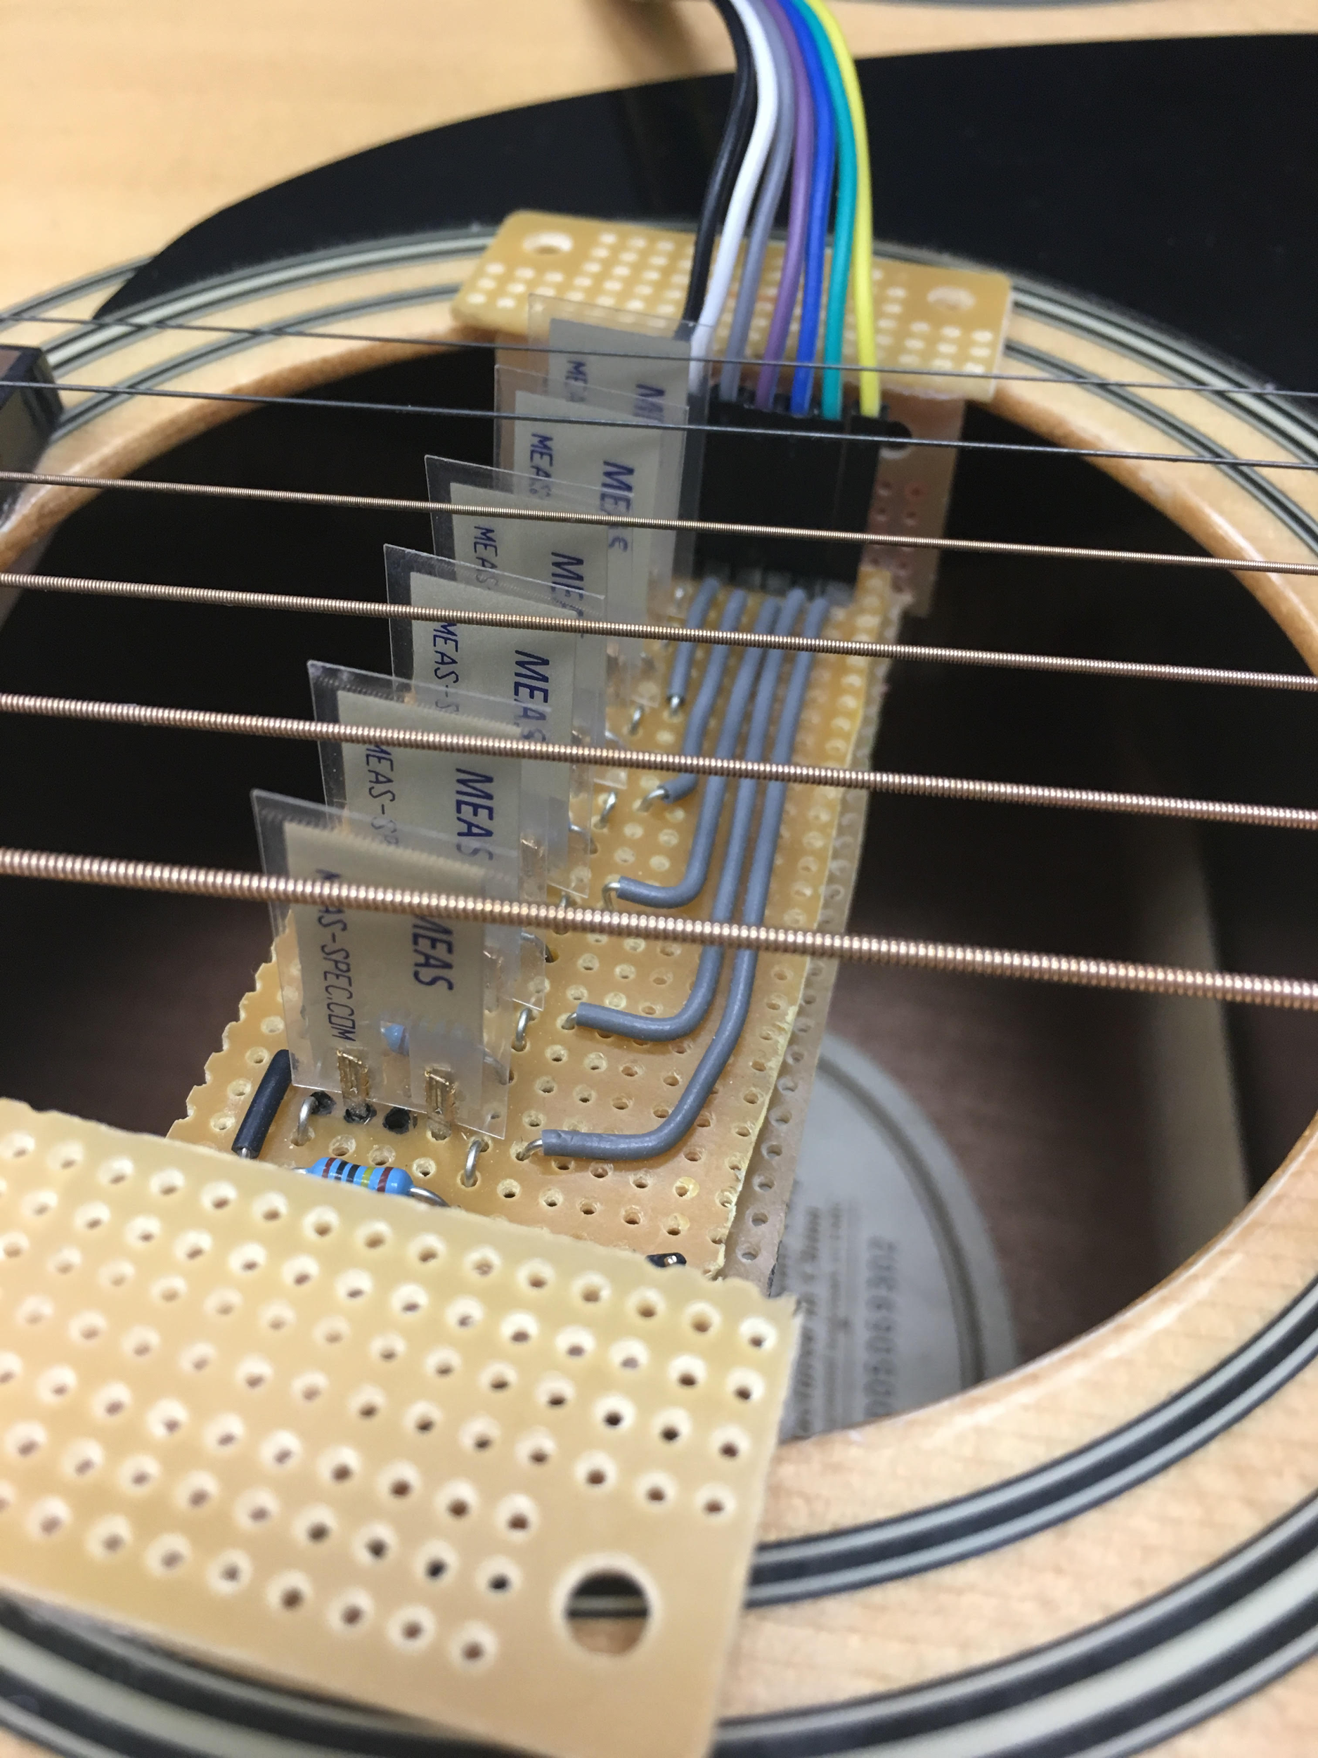
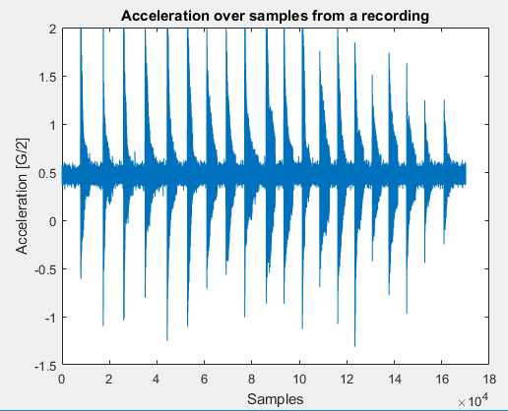
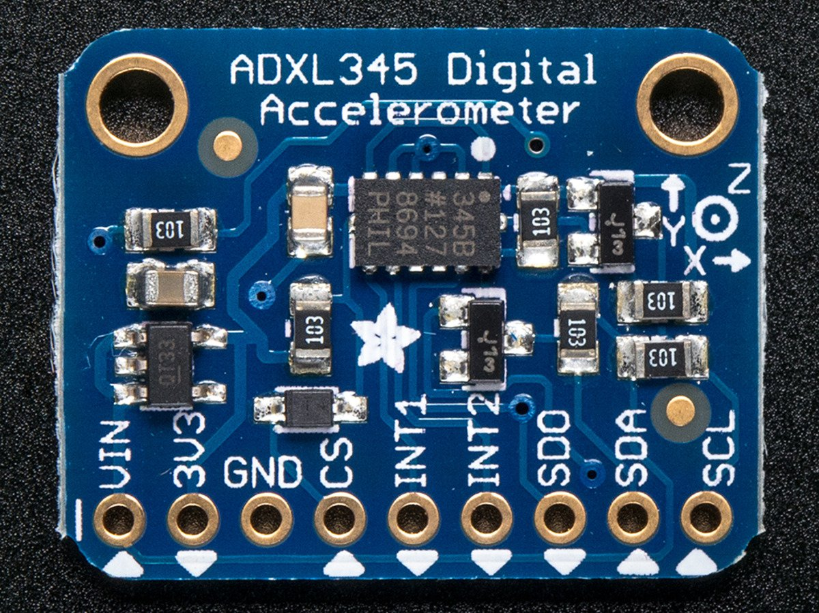
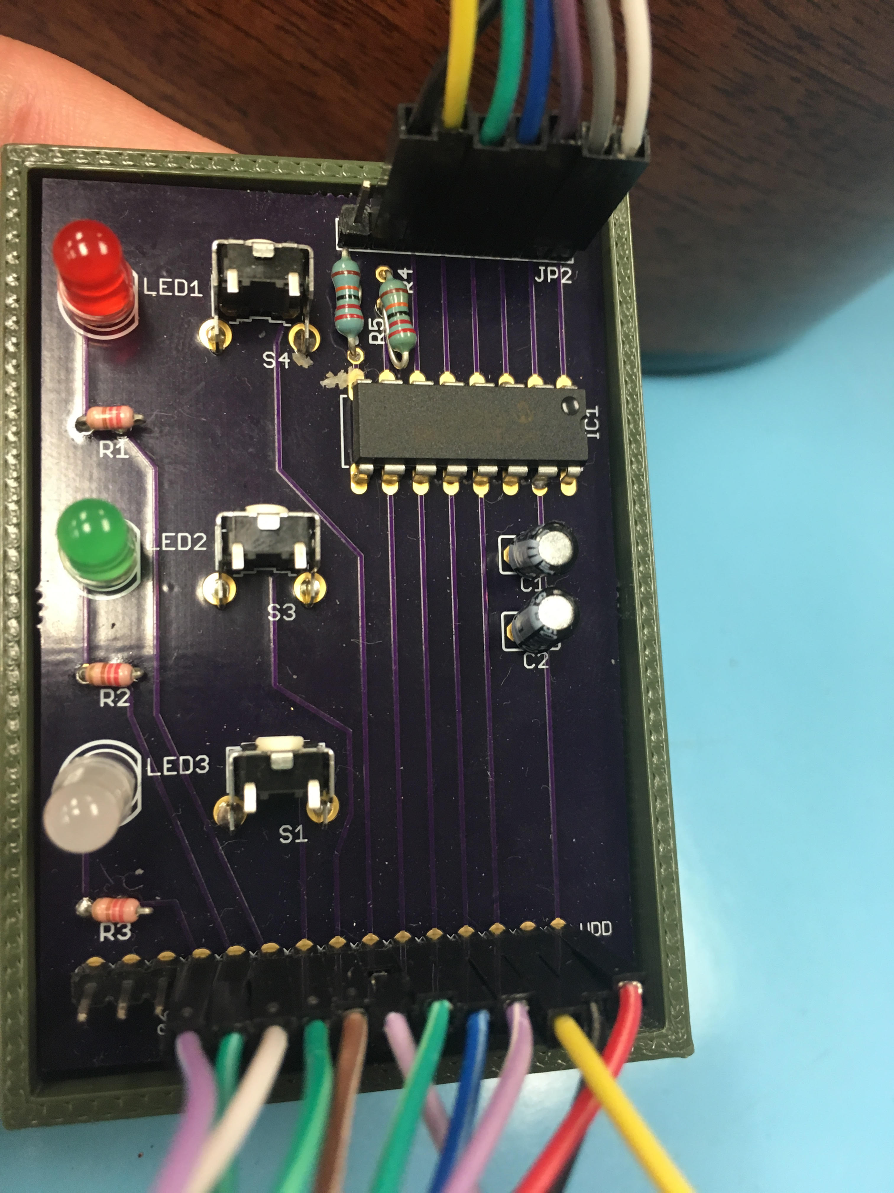
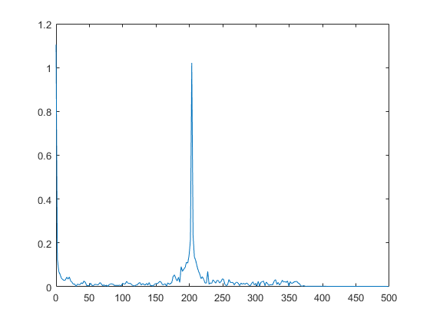
Sensors
Data Logging
Six piezo film vibration sensors are placed adjacent to the guitar strings
An MCP3008 ADC allows for the Raspberry Pi to process the analog outputs of the sensors
Manually set the intensity thresholds within the QuickTab Python Script
Optimized thresholds improve the performance of signal processing
Data from multiple sources is recorded and organized by python code on a Raspberry Pi
The accelerometer, ADXL345, interfaces with the Pi through an I²C bus operating in FIFO mode at 3200Hz
The highest frequency available on our guitar is 1047Hz, meaning that our chosen sampling rate of 3200Hz satisfies the minimum constraints of the Nyquist rate (i.e. 2096Hz)
The flex sensors are directly connected to the GPIO pins of the Pi, sending signals when specific conditions are met (as described in “Sensors”)
Depending on the inputs from the UI, the data is stored in two files for either “Calibration” or “Recording”
These recordings are automatically stored both in a local folder and transmitted wirelessly to our project’s e-mail address
User Interface and PCB
Easy to use interface located at the base of the guitar, consisting of 3 buttons and 3 LEDS
Red LED: Signals that the you are recording
Green LED: Signals that the device is currently ready to record/calibrate or is in the process of recording or calibrating
White LED: Signals you are recording your calibration file
The Record Button, located next to the red LED, allows the user to record the notes they play on the guitar and produce a tablature output.
The Shutoff Button, located next to the Green LED, allows the user a quick way of shutting off QuickTab
The Calibration Button, located next to the white LED, allows the user to record the 6 base frequencies of their guitar which will adjust the Tablature output accordingly
Signal Processing
String and Fret detection
Raw ADXL and vibration sensor data is read in via email from the Raspberry Pi
We iterate through the sensor data to find out what strings were played
For each note detected a filter is applied that corresponds to the string played
The timestamp from the vibration sensors is used to determine where to take the FFT’s
Logical statements are then used to determine correct frequency from FFT
The user interface also contains connections to the Raspberry Pi and the vibration sensors
The connections from the vibration sensors relay voltages induced by flexing the sensors to the A/D converter
From the A/D converter these vibrations are attributed to strings
FFT printout for frequency of 220Hz
Calibration
Accurate fret detection requires knowledge of base frequency of each string. We have incorporated a calibration function to accommodate any tuning.
When initialized the code stores the values of the open string frequencies as the standard tuning values (E, A, D, G, B, e)
The calibrate button on the PCB will send a calibrate file that can be read into the code
This data is processed the same way as above and the new values are stored in the string frequency array until a new calibration file is read in
Cost
Development
Production
Part | Price
Raspberry Pi | 35
Accelerometer | 18
Vibration Sensors(x6) | 45
PCB (All components) | 35
Total | 133
Part | Price
Raspberry Pi | 35
Accelerometer | 18
Vibration Sensors(x6) | 18
PCB (All components) | 13
Total | 84
Demo
Mary had a little lamb tablature from 911tabs.com

